Slide 1

Group 19
22070696G GONG Wangjiang (Leader)
22063416G TANG Haoyue
22054513G GU Zhexuan
22040722G AUYEUNG Chikeung
22048817G LI Bo

Slide 2

Member Duty
Member | Duty
GONG Wangjiang | data prepocessing, Task 2 CNN model, presentation, report
TANG Haoyue | Task1,Task 3 FL model, presentation, report
GU Zhexuan | data prepocessing, Task 2 Attention model, Task 3 FL model, report
AUYEUNG Chikeung | data prepocessing, Task1, Task2 ML model, report, PPT
LI Bo | Task3 FL model, report, PPT

Slide 3
Map Reduce

Slide 4

Introduction
In the real estate market, house prices are influenced by a variety of factors, including location, size, noise level, air conditions, etc.
To help real estate investors make informed
decisions.
We identify latent patterns and develop predictive models that are useful to make data-driven decisions on house transactions.

Slide 5
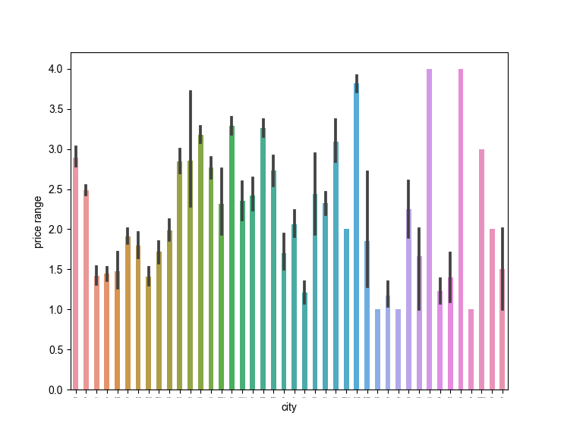
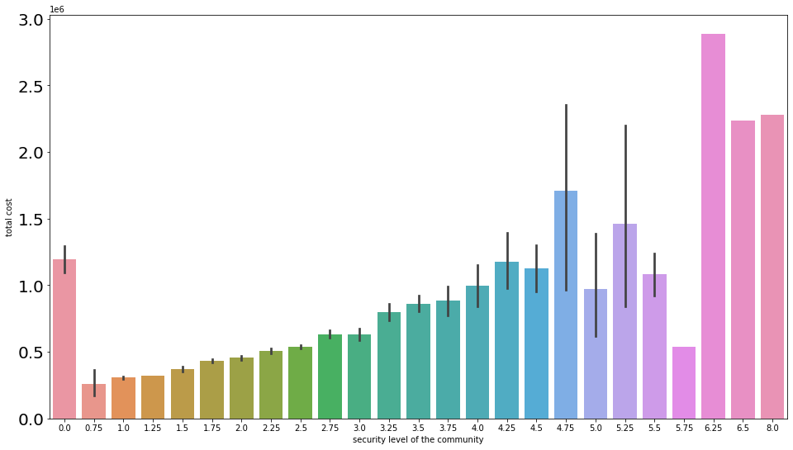
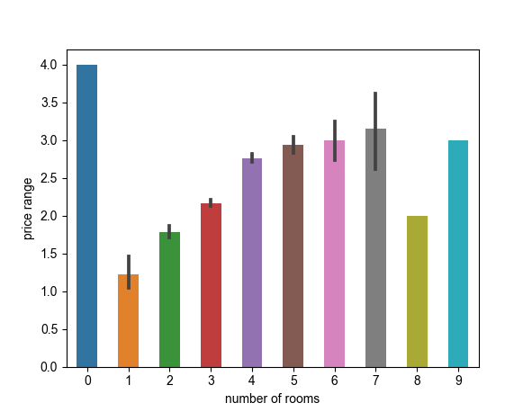
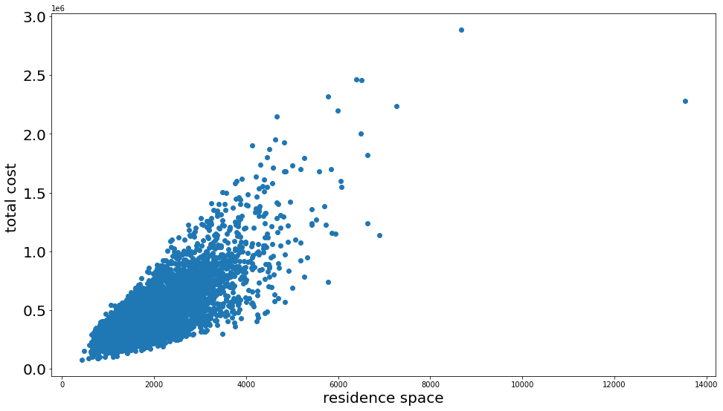
Data preprocessing/analytics

Slide 6
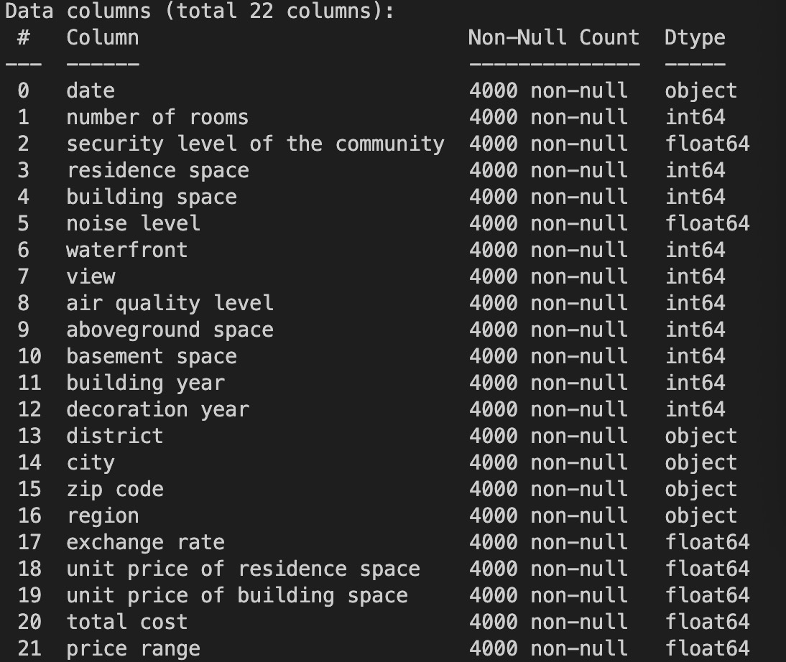
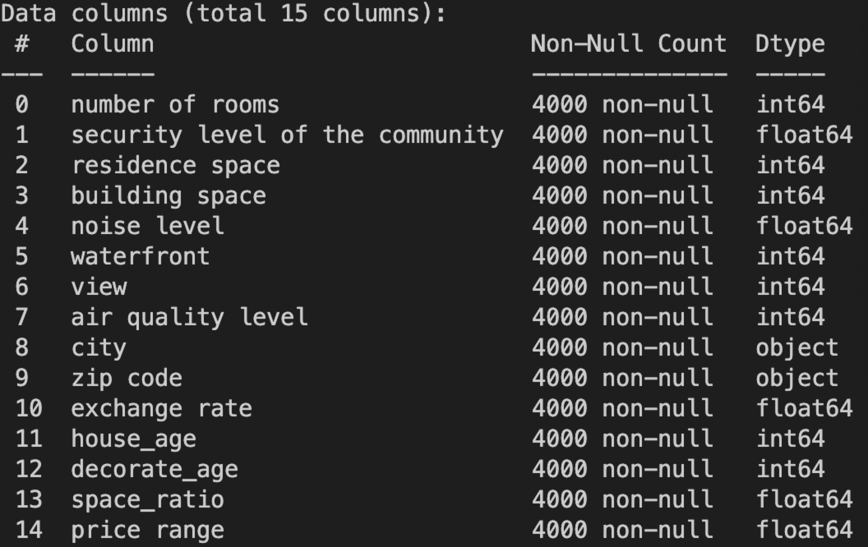
Data preprocessing/analytics
date time scale is too small Drop！
district too specific Drop！
region no difference Drop！
decoration year < building year Error！
house_age
decorate_age Transform!
space_ratio(above/underground)
city & zip code Embedding！

Slide 7
Data preprocessing/analytics

Slide 8
Model design and implementation

Slide 9
Model design and implementation

Slide 10
Framework of federated learning

Slide 11
Framework of federated learning

Slide 12
Performance evaluation and discussions

Slide 13
Performance evaluation and discussions

Slide 14
Conclusion and future work

Slide 15
Reference

